Slide 1


2025
lwo.by
CASH MANAGEMENT
Cash management system for banks

Slide 2
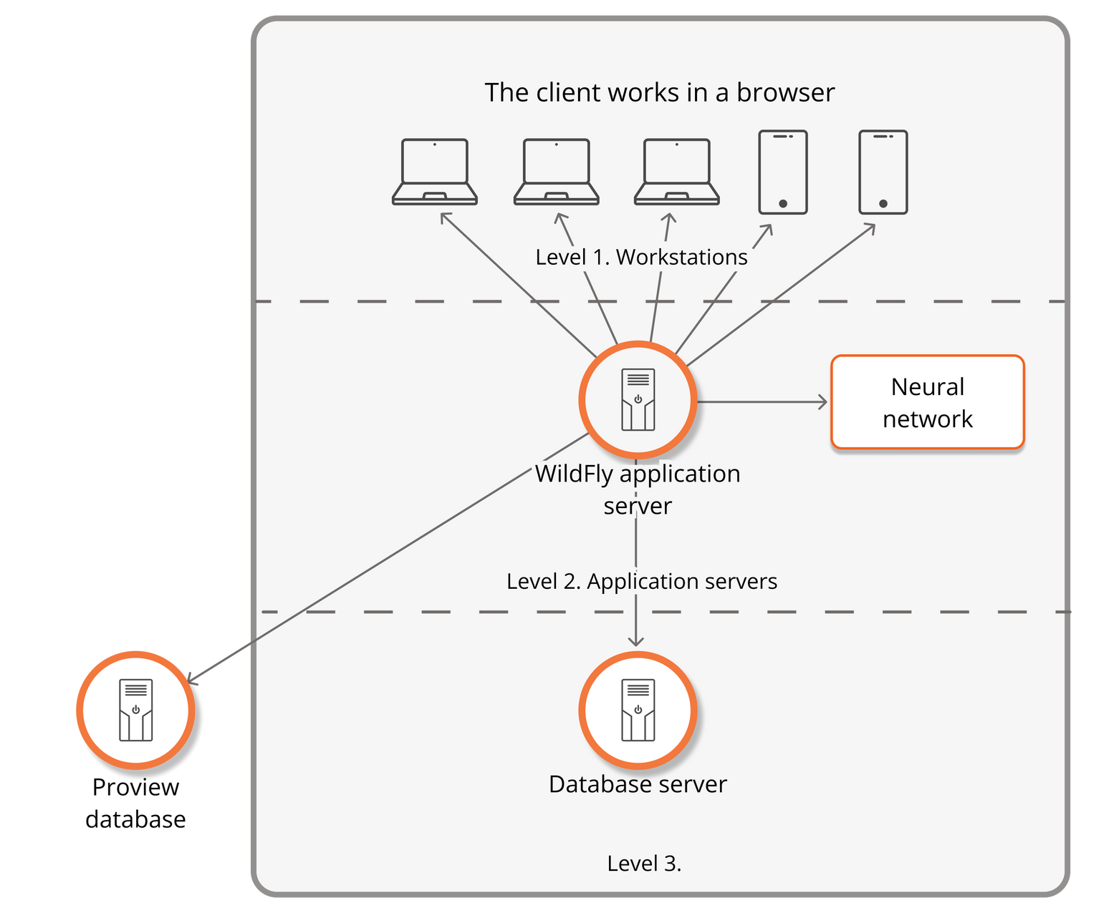

TOPOLOGY
Ability to use different database management systems
Using neural network to forecast cash dispenses
User-friendly web-interface suitable for working on various devices
Integration with ProView, OpenWay, and similar software to obtain collection points, cash counter data
Flexibility and numerous configuration options

Slide 3
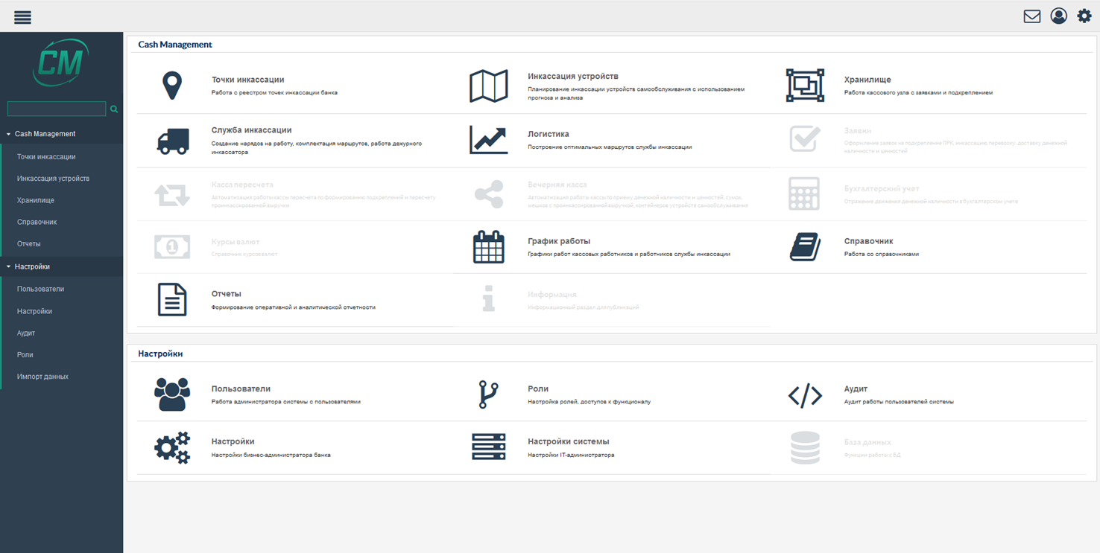

USER INTERFACE
  Convenience
  Modular design
  Elegant style
  Flexibility

Slide 4
SYSTEM FUNCTIONALITY
Retrieving and processing data on cards of self-service terminals from the software complex ProView, OpenWay, the bank’s processing system, and similar software
Retrieving and processing data on cash balances and turnovers of self-service terminals from the software complex ProView, OpenWay, the bank’s processing system, and similar software
Creating the forecasting model of future dispenses for each ATM
Automatically including the ATMs that are running out of cash into the resupply schedule
Automatically including unattended terminals with the cash-in function into the schedule according to 4 criteria
Calculating the optimal amount of ATM loading with regard to the current funding rate and cost of cash collection service
Distribute amounts to cassettes depending on the face value of the cassette banknotes
Taking the device’s insurance amount into consideration
Creating and configuring access rights, roles, user functions by the system administrator
Maintaining 2 or more holiday calendars
Automatically drawing application letters according to the configured template, and many other functions
Forecasting loading for cash recycling ATMs

Slide 5

FORECASTING CASH FLOWS
To forecast cash dispense flow of unattended terminals and cash desk debit and credit, the neural network is used as a deep learning library.
It includes implementation of restricted Boltzmann machine, deep trust network, deep autoencoder, stacked denoising autoencoder, recursive neural tensor network, word2vec, doc2vec, GloVe.
Training is carried out with the application of usual multi-layer neural networks, as well as complex networks where the computational graph is defined.
It includes the class to work with the n-dimensional array.
In simple words, the neural network uses multiple statistic forecast methods that can be applied in various ways to forecast a row of numbers.
In the course of continuous training (re-training), the neural network learns to select the optimal model to forecast a specific row of numbers (for the specific device, cash desk, vault) from among numerous forecasting methods.
Thus, the software contains a complex of forecasting algorithms, not just a single one. The neural network independently decides which method to use on a case-by-case basis to achieve the maximum effect.

Slide 6

MANAGING CASH FLOW AT CASH DESKS
  Creating the forecasting model based on the statistic data from cash desk transactions
  Preparing decisions on the advance amount for cash desks
  Including amounts requested by retail business and lending departments according to their inquiries

Slide 7
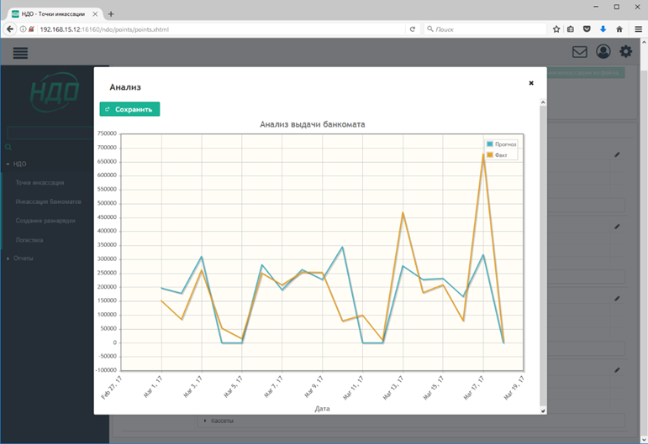
CREATING CASH COLLECTION SCHEDULE
Possibility to retrieve the statistic data
  of dispenses from the file at the initial process stage
  Taking into consideration insurance amounts of payment terminals, ATMs and other unattended devices located nearby
Creating the forecasting model based
on the statistic data of transactions
  in the ATM network
Preparing decisions on the amount
of loading and date of cash collection service of ATMs

Slide 8

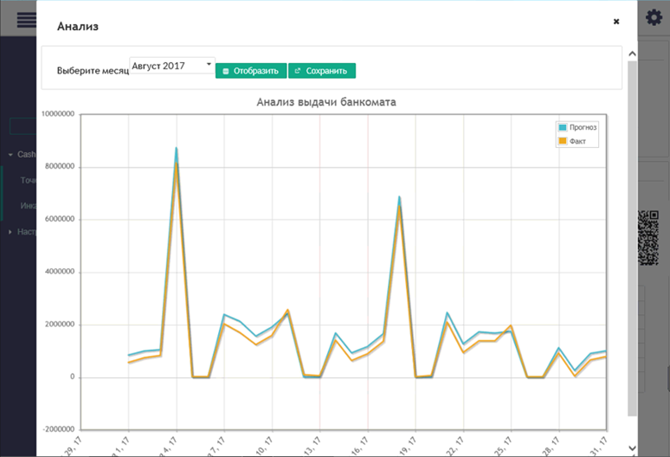
INCLUSION OF SELF-SERVICE TERMINALS (STS) WITH CASH-IN FUNCTION INTO THE SCHEDULE
Inclusion of STs into the cash collection service schedule by optimisation criteria
  Inclusion of STs into the cash collection service schedule when the insurance amount is exceeded, or banknote quantity threshold is achieved
Viewing face value of banknotes in the cassettes of STs

Slide 9
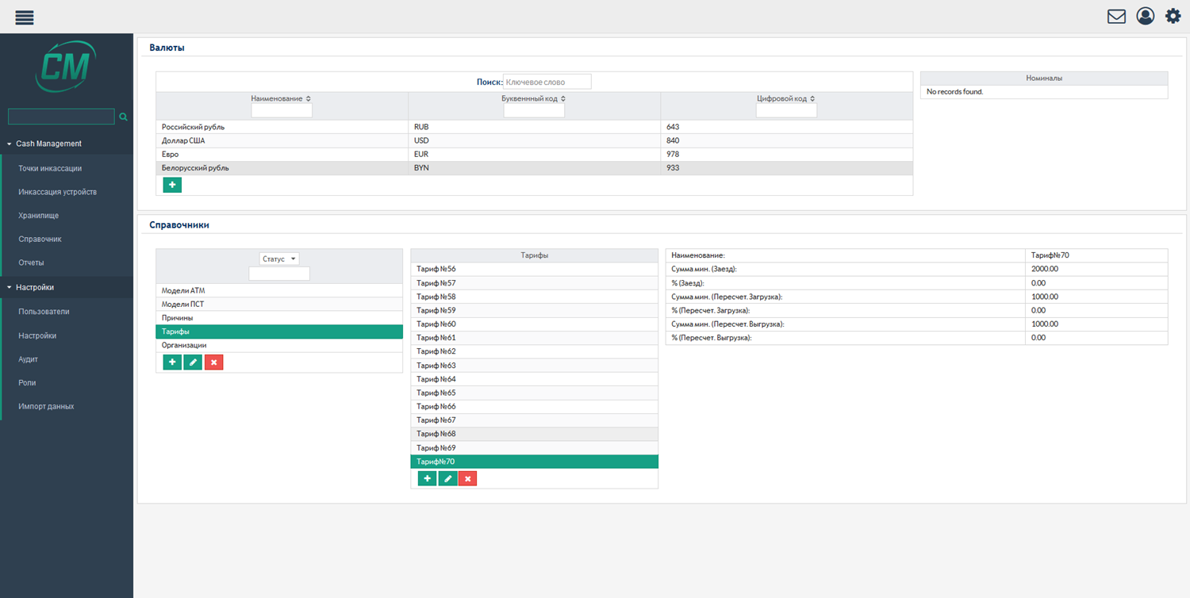
CONSIDERING THIRD-PARTY CASH COLLECTION SERVICE FEES
Differentiated fee system
Possibility to account for the average cost of cash collection service
Calculation of the cost of cash collection service according to the fee directory

Slide 10
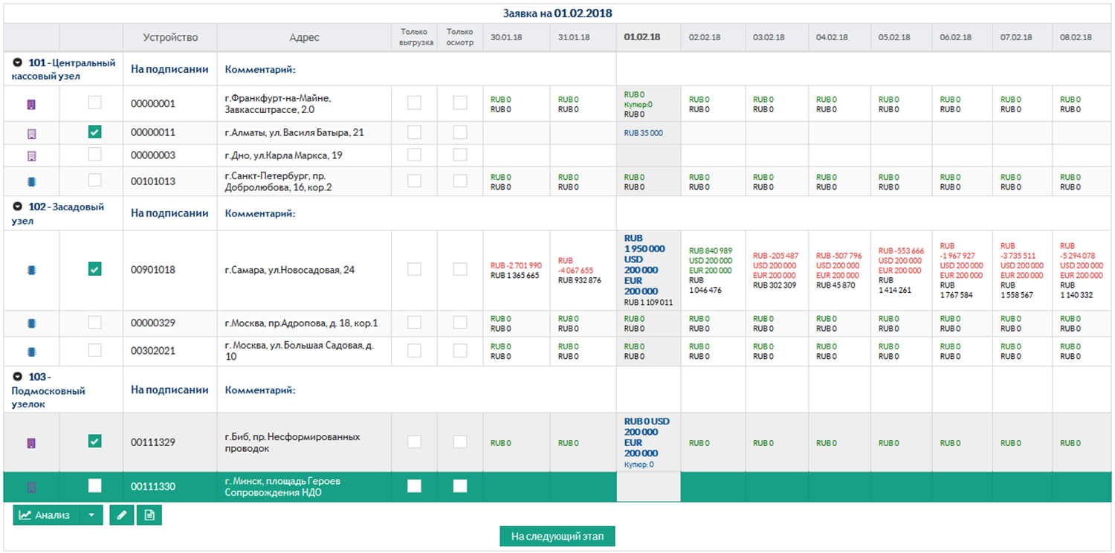
DRAWING CASH COLLECTION SERVICE SCHEDULE
Viewing the analysis result
Sending requests to cash desk operating units for approval
Breakdown by cash desk operating units
Editing the suggested amount

Slide 11
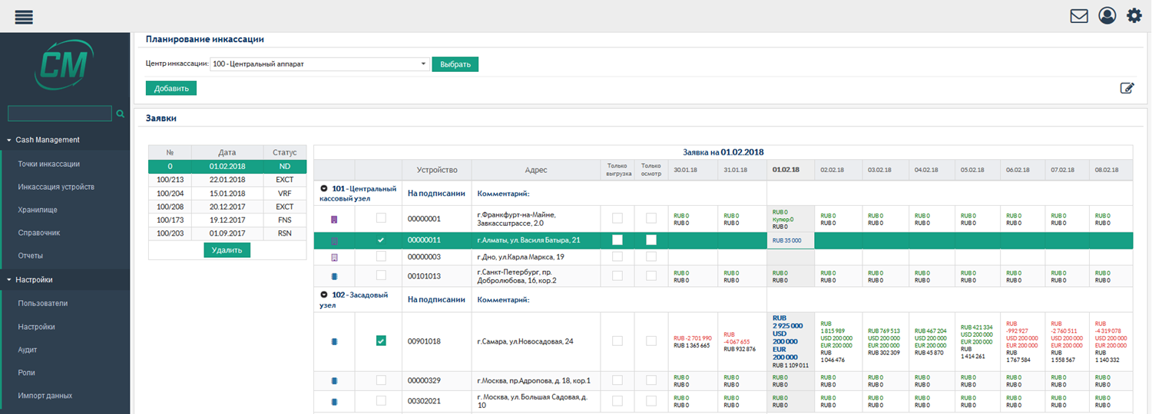
BANK’S COSTS OPTIMISATION
Saving labor costs for analysis and loading schedule preparation
Saving insurance amounts
Saving сash desk resources

Slide 12
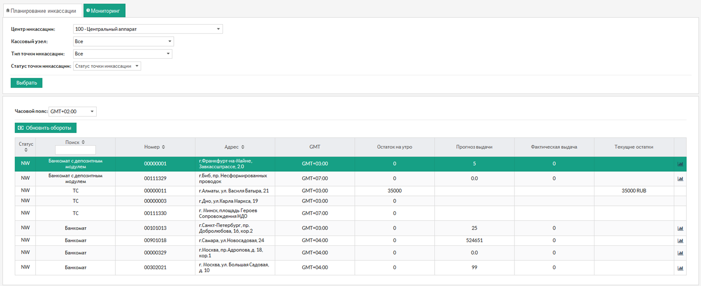
MONITORING OF CURRENT CASH BALANCES OF DEVICES
Current cash balances of devices
Possibility to response promptly to drastic changes
Morning balances
Highlighting the device that requires attention
Forecast and actual dispense for the current day

Slide 13
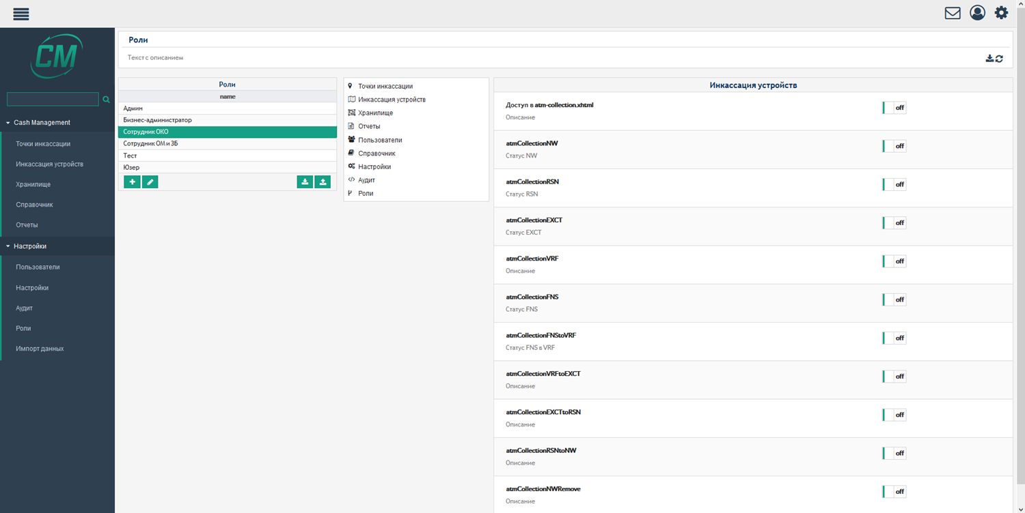
ROLE CONFIGURATOR
Creating roles
Distributing access rights for roles
Distributing functions
Exporting/importing roles

Slide 14
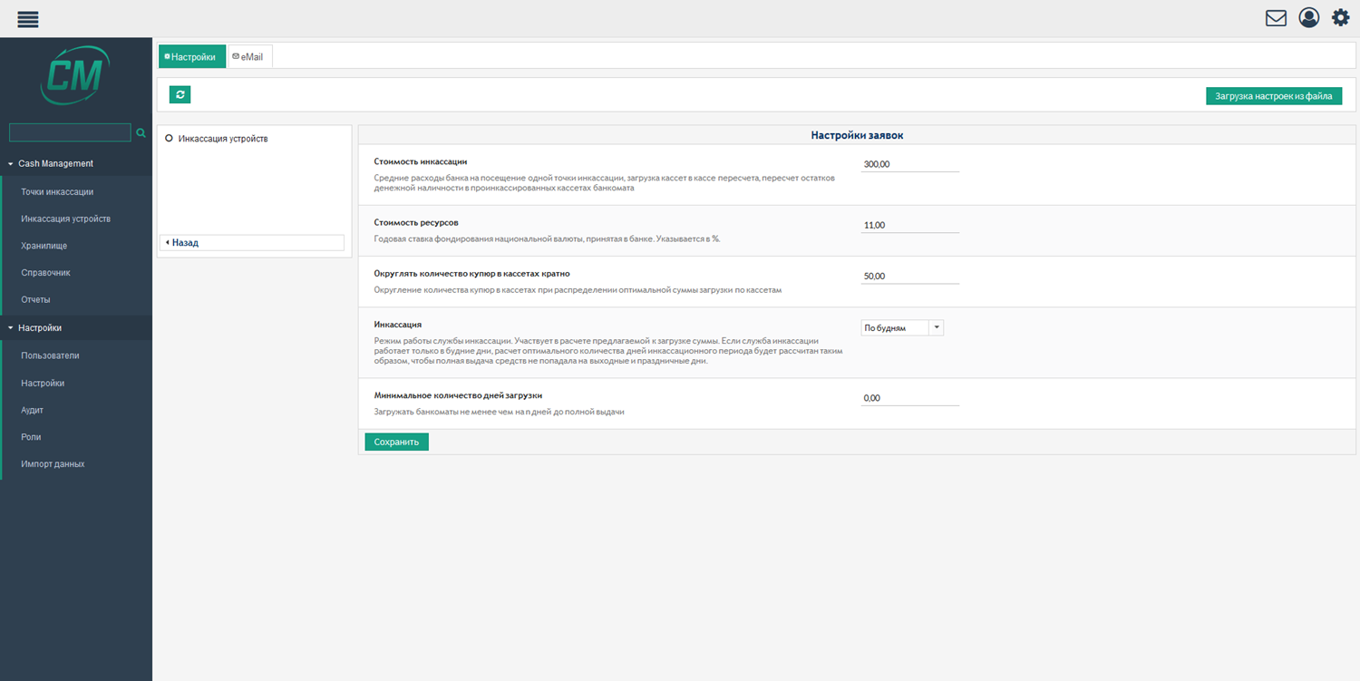
BUSINESS ADMINISTRATOR SETTINGS
Average cost of cash collection service and current funding rate
Rules for rounding the number of banknotes in cassettes
Working schedule of the cash collection unit: business days/ daily
Minimum number of loading days

Slide 15
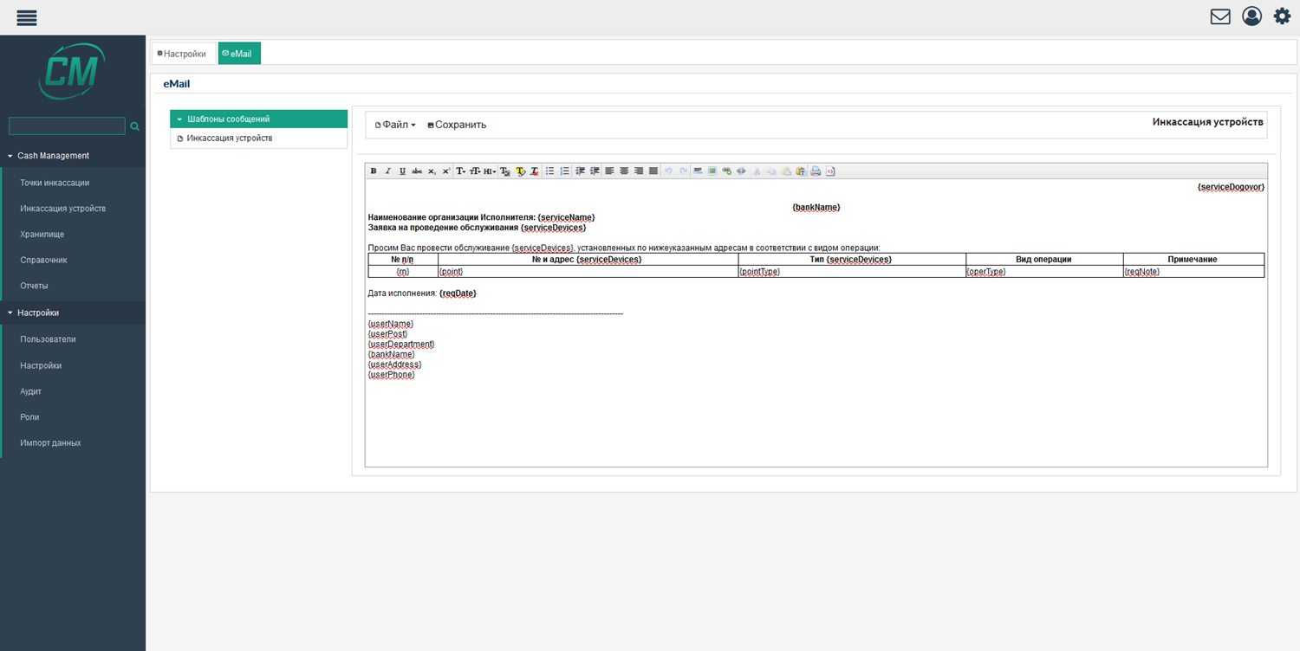
SENDING LETTERS
Configuring the letter template
Sending an e-mail to the involved parties with an attached application

Slide 16
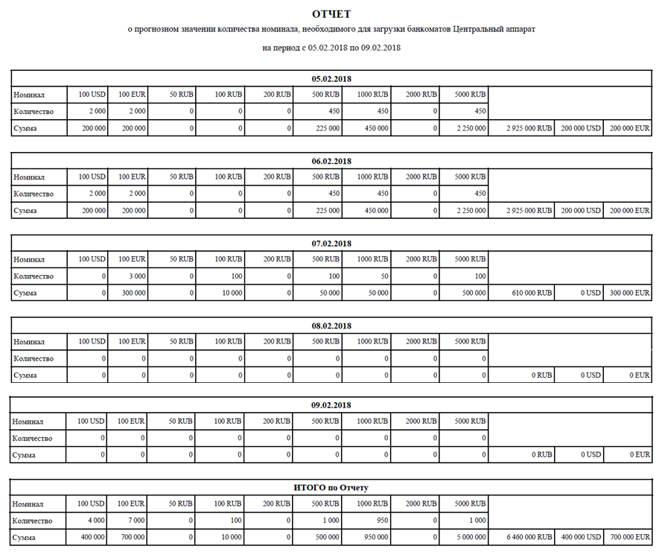
FORECASTING CASH DEMANDS
Forecasting cash demands for future period
Total amounts broken down by banknote face value

Slide 17
ADVANTAGES
Reliable system for optimisation of the bank’s cash management
Possibility of centralisation and de-centralisation of operational functions
Automation of assessment of the necessity of resupply and collection service of devices and loading amounts
Full financial monitoring of unattended terminals
Efficient system of forecasting cash desk resources
Optimisation of ATM loading amounts
Convenient configurator of user access roles

Slide 18
INNOVATION’S PACE

