Slide 1


2025
lwo.by
MARKETPLACE
AS AN INSTRUMENT OF SALES GROWTH

Slide 2


WHAT IS MARKETPLACE?
Marketplace is a platform where many sellers offer their products
  or solutions to many buyers

Slide 3
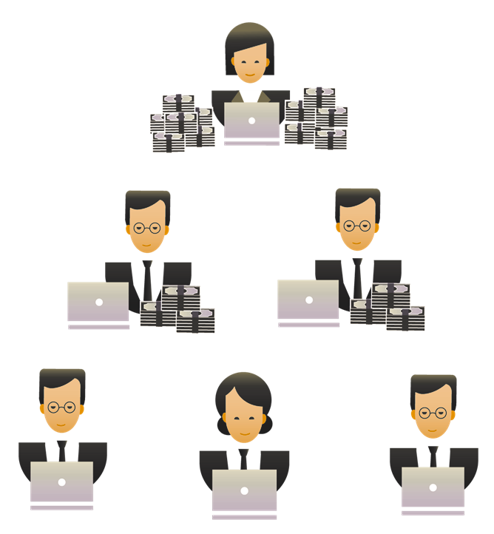
THE PRECONDITIONS OF MARKETPLACES APPEARANCE
Active buyers (have bought something online at least once in the last 30 days)
28%
51%
Had online shopping experience
71%
The Internet users

Slide 4

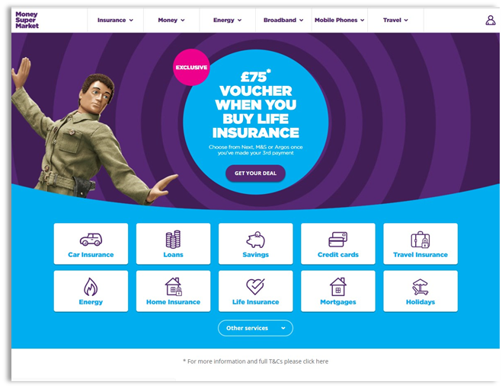
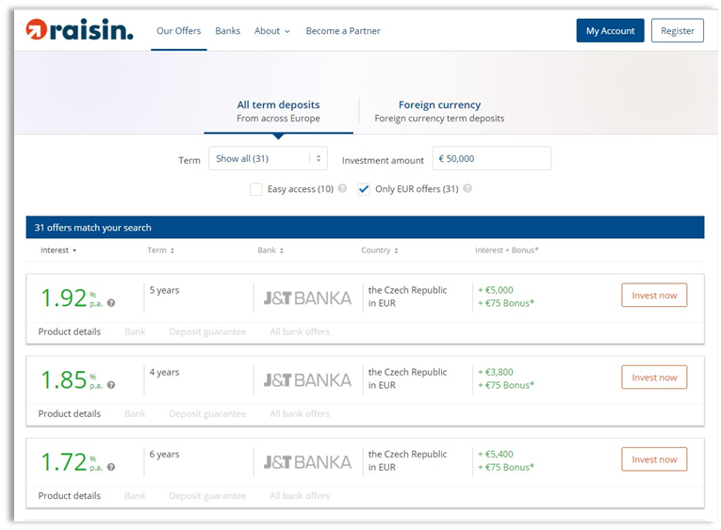
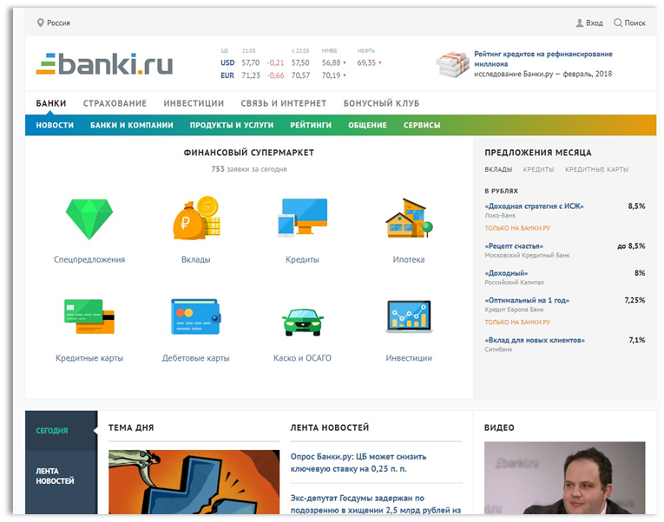
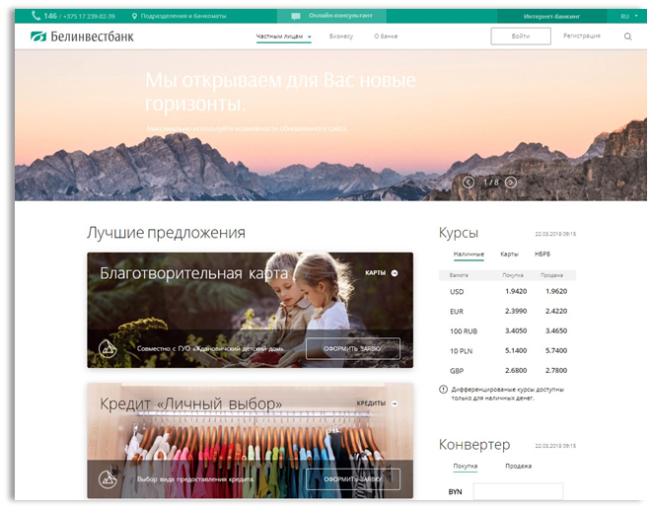
GLOBAL TRENDS in THE DEVELOPMENT OF MARKETPLACES
Can bank products be sold through an aggregator?
The Great Britain:
  Moneysupermarket.com
Europe:
Raisin.com
Russia:
Banki.ru, Sravni.ru,Tinkoff.ru
Belarus:
Recard.by, Belinvestbank.by

Slide 5
CUSTOMERS DESIRES
How do you know what the customer needs?
  Self-sustained product selection
  Product comparison
Easy and quick product ordering

Slide 6





SALES MODELS
Direct sales
Horizontally integrated
Marketplace
Bank
Bank
Vertically integrated
Marketplace
Insurance
Insurance
Insurance
Bank
Bank
Bank

Slide 7
VERTICALLY INTEGRATED MARKETPLACE
1.Selection
2.Payment
Internet-banking
Mobile banking
Marketplace
Bank web site
The integration with remote banking service system and bank ABS

Slide 8

VERTICALLY INTEGRATED MARKETPLACE
Bank ABS
Internet-banking
Import of product and service data
Messengers
Marketplace
Bank web site
SSO
Social networks
Unified database of products and services
Mobile banking
SSO (single sign-on)
The integration with remote banking service system and bank ABS
Deep-linking

Slide 9

MARKETPLACE OF OJSC «BELINVESTBANK»

Slide 10
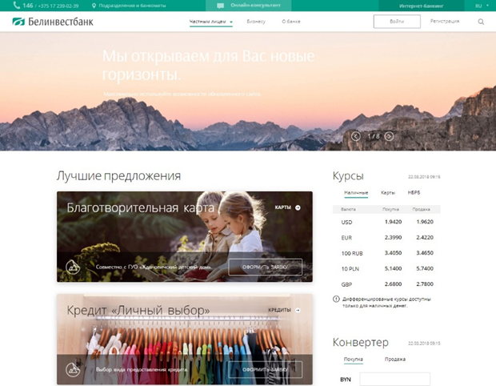
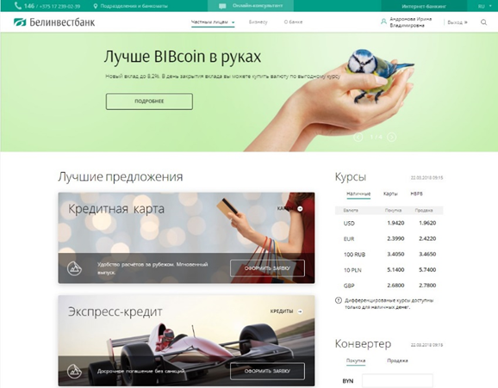
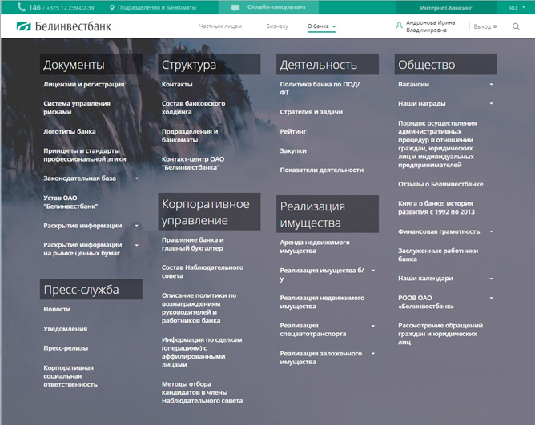
STRUCTURE
  Bank information
Section for legal entities
Section for physical entities

Slide 11
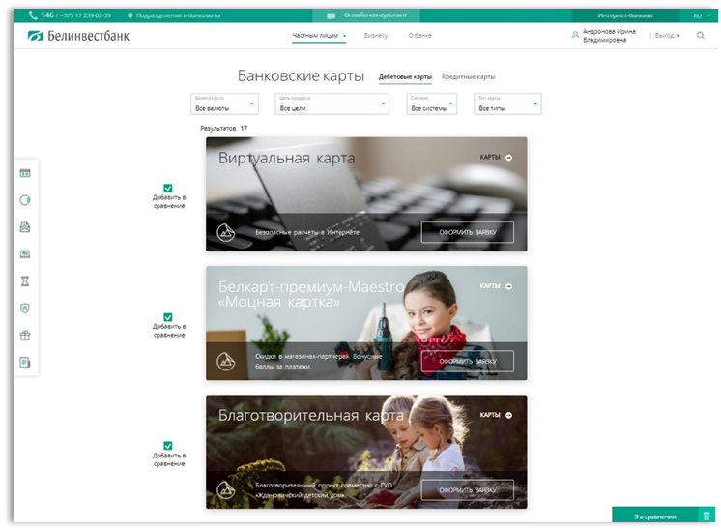
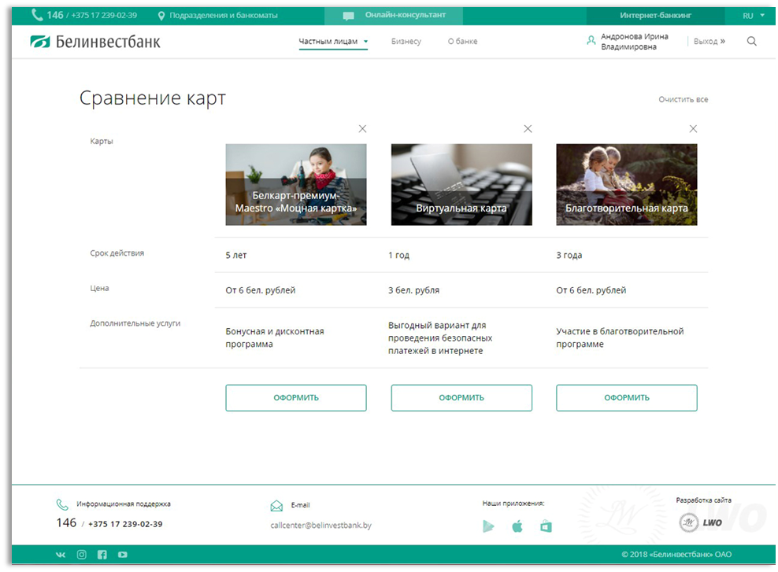

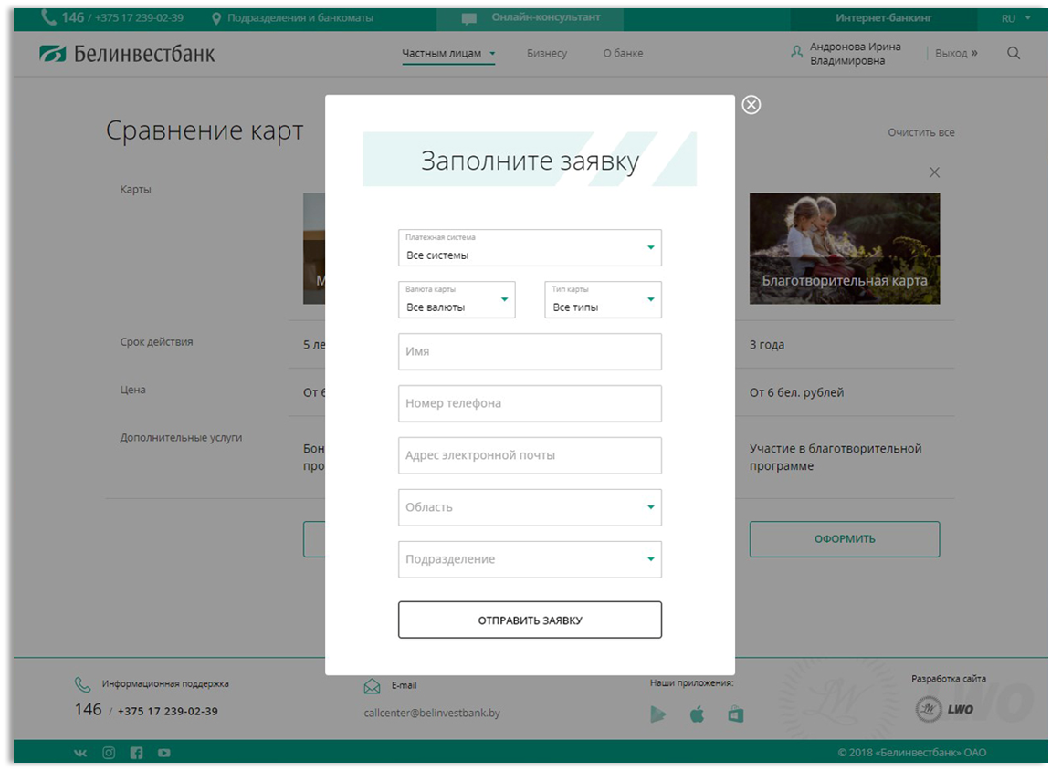

PRODUCTS COMPARISON

Slide 12
PARTNERSHIP RELATIONS
For customers:
  time savings,
  large selection in one place
For the bank:
  increase of customer loyalty
  agency sales income
  expansion of product range
  discovery of potential of customer data base
For partners:
  getting a site with high traffic

Slide 13
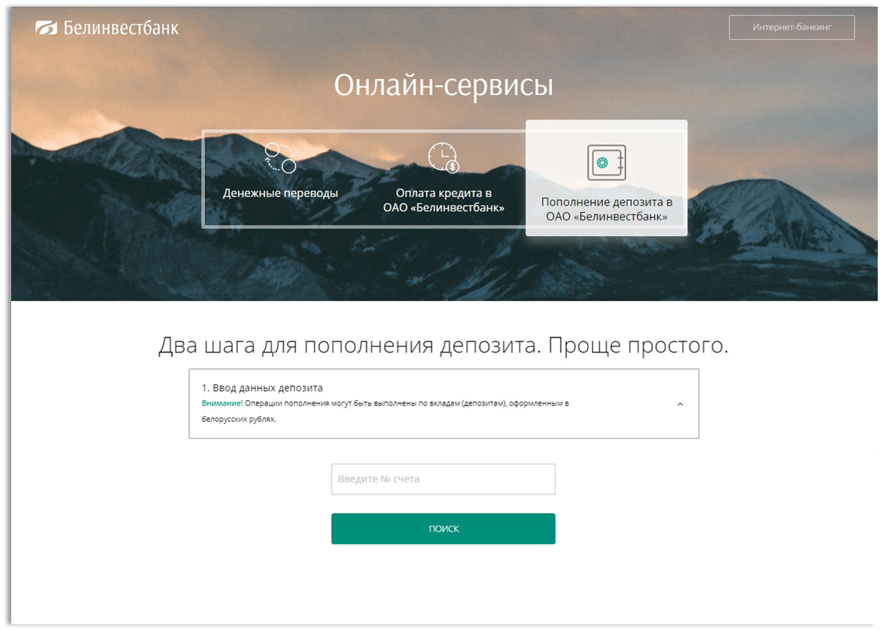
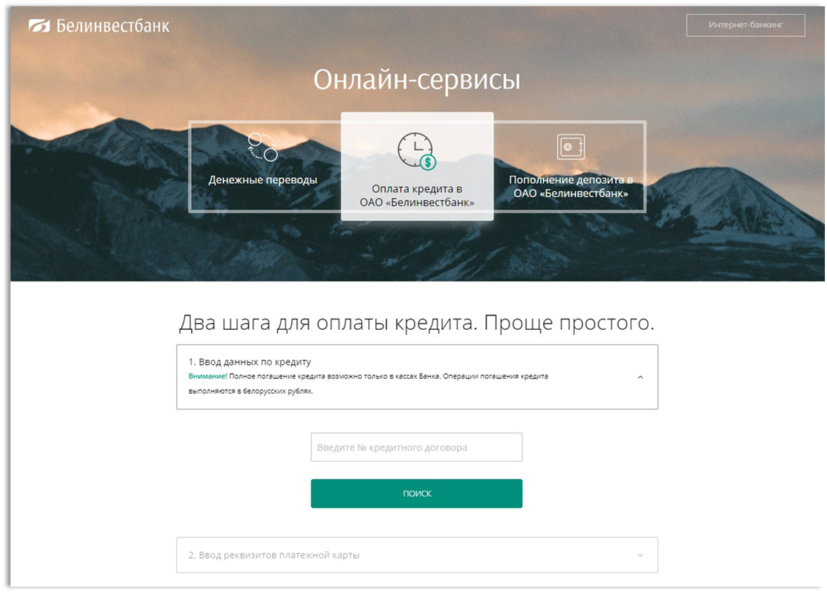
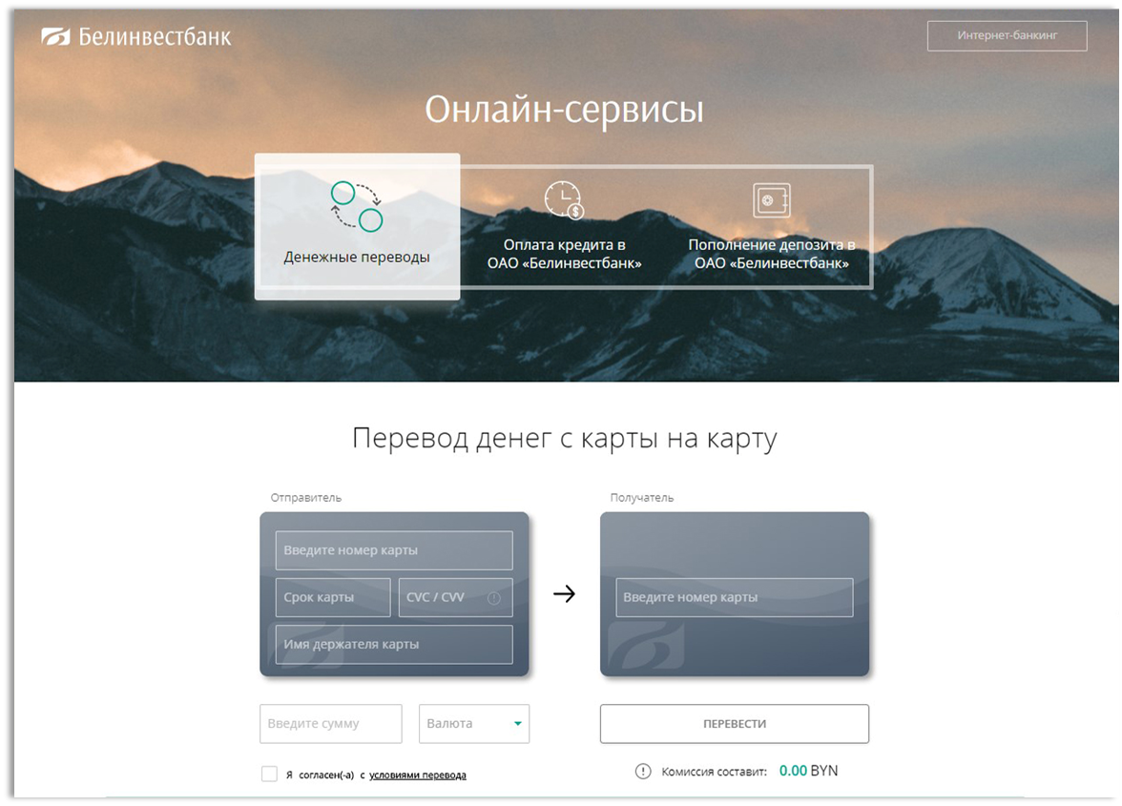
ONLINE SERVICES

Slide 14
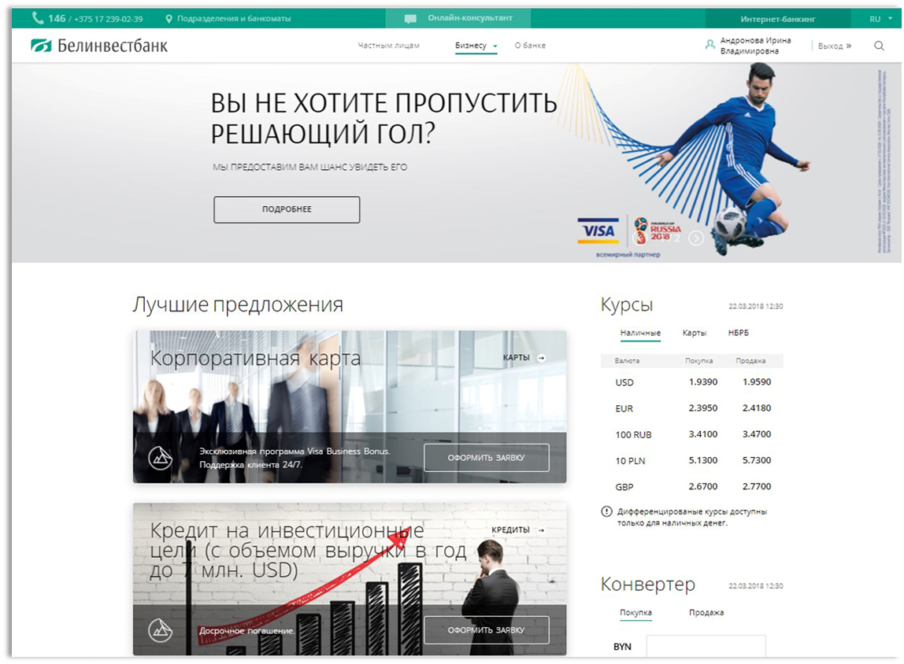
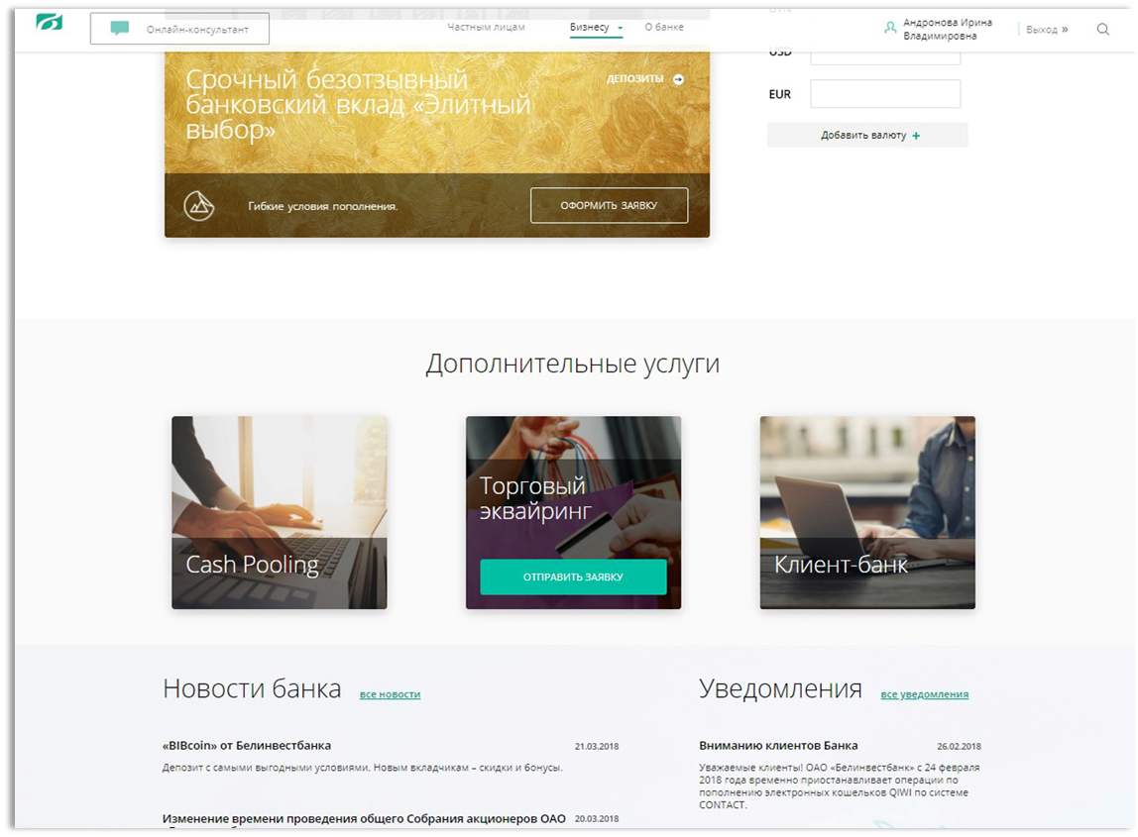
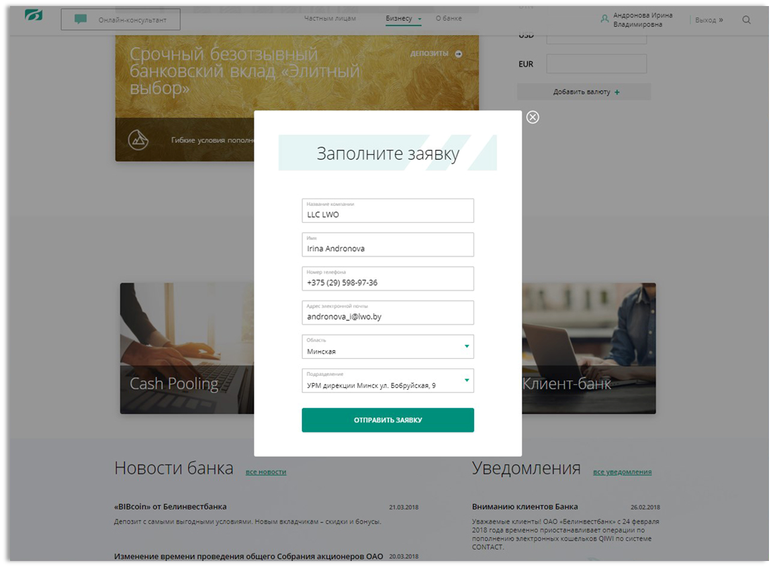
FOR BUSINESS

Slide 15
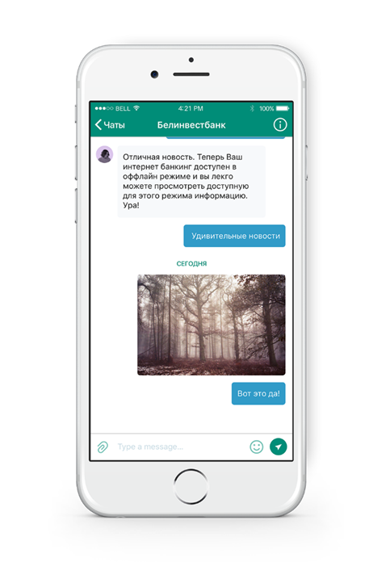
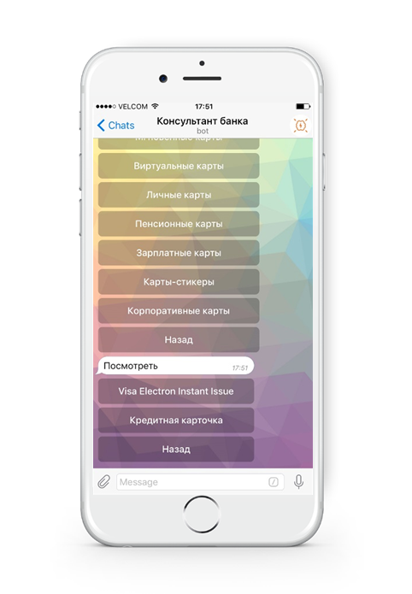
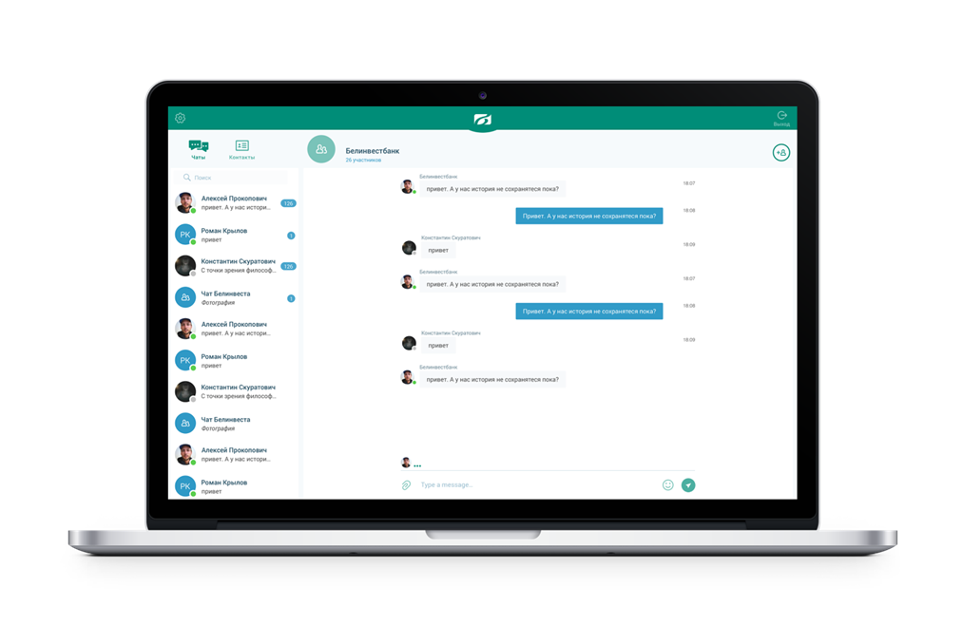
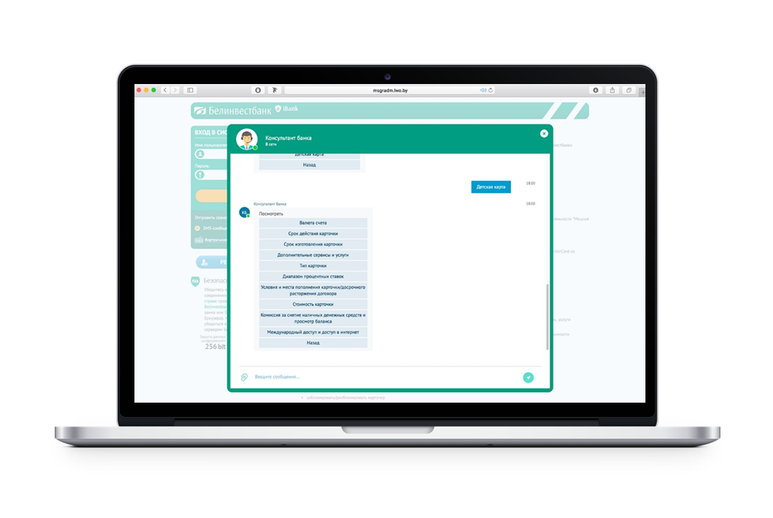
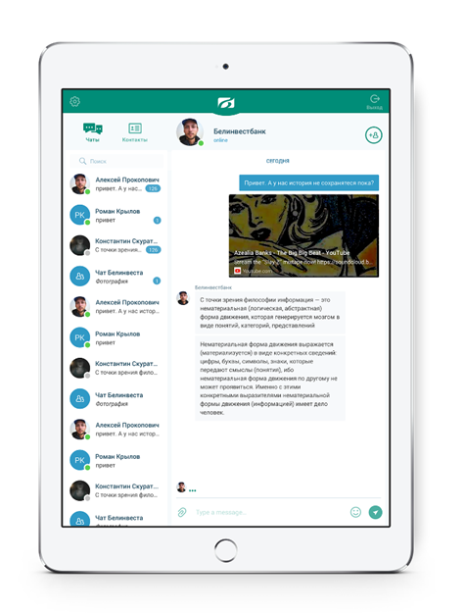

ИНТЕГРИРОВАННЫЙ ОНЛАЙН-КОНСУЛЬТАНТ
Service in messengers and social networks
Service on the site, in the Internet- and mobile-banking
Workplace of an employee of the bank Contact Center

Slide 16
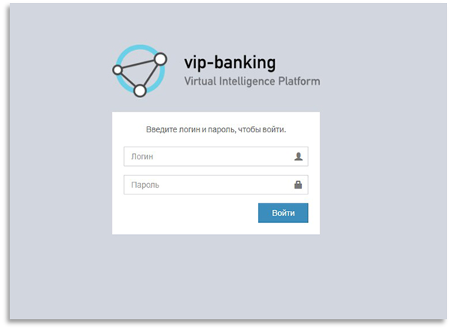
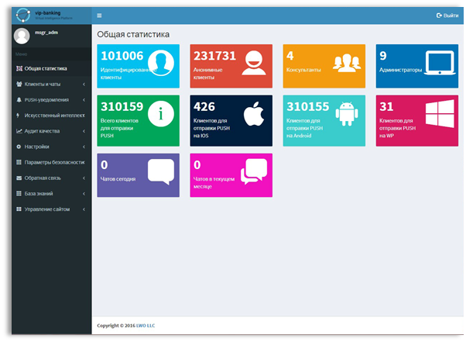
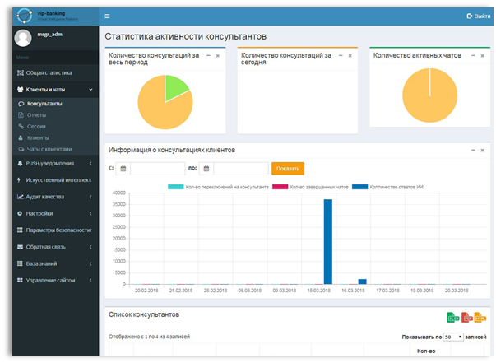
CONTENT MANAGEMENT SYSTEM

Slide 17
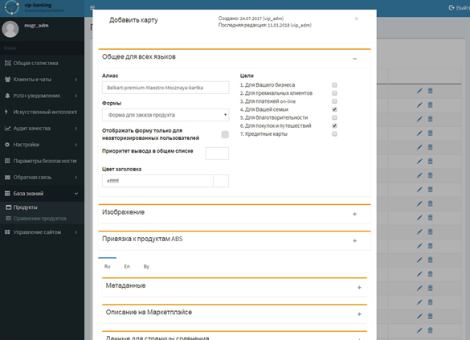
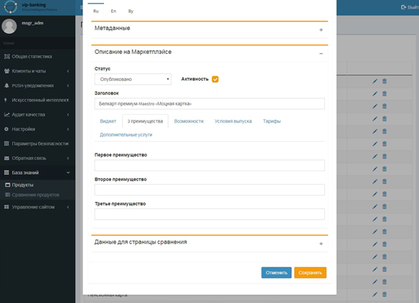
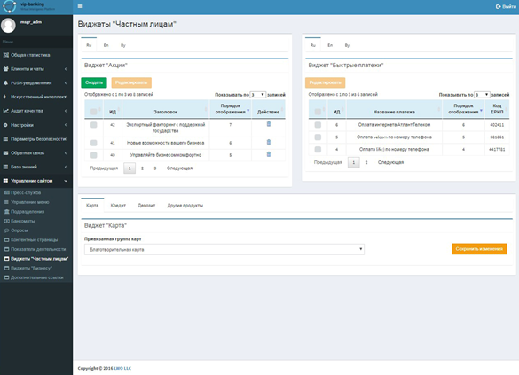
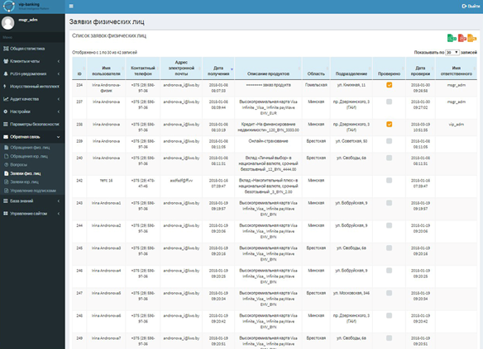
CONTENT MANAGEMENT SYSTEM

Slide 18

BENEFITS OF USING
Advanced product selection
Online ordering of products in one step
Deep-linking technology
Using Single Sign-On (SSO) Technology
Content Management System (CMS)
Online consultant and intelligent assistant
High safety standards
Individual responsive web design
Possibility of integration with other bank solutions

Slide 19
HORIZONTALLY INTEGRATED MARKETPLACE
Bank
Insurance
Insurance
Bank
Bank

Slide 20
THE PLUSES OF MARKETPLACE USING
For banks
For customers
Reduced customer service costs
Attracting a new customer data base
Reduced advertisements costs
The increased comparability of services
The competition at the product and service level
Access to services 24/7
Expansion of the range
Ability to perform transactions from one site
Increased availability of financial services

Slide 21
THE MINUSES OF MARKETPLACE USING
Standardized open platform API for all participants
You pay every time your customer makes a purchase
The customer does not "keep in mind" which bank provides this or that service
Regular demonstration of competitor advertisements
Many platforms with their own rules.

Slide 22
WHAT HINDERS THE DEVELOPMENT of FINANCE MARKETPLACES?
  Myth: a buyer will come for my wonderful product anyway
  Great investment conservatism
Low level of financial literacy

Slide 23
INNOVATION’S PACE

